Slide 1


PLEDGE
PILOT
A Crowdfunding application that rewards people for donating to initiatives

Slide 2
OVERVIEW
01
02
03
Our Team
Techstack
PledgePilot mission
04
05
06
Description
Working
References

Slide 3







PLEDGEPILOT DEVELOPER TEAM
Kartikey
Vijayakumar
Hebbar
Deepansh
Chaturvedi
Aaryan
Praveen
Kartik Vijay
Shanbhag

Slide 4










TECHNICAL STACK USED

Slide 5
DESCRIPTION
PledgePilot is a crowdfunding application which incentivizes people for funding hobby projects and initiatives to help them grow
The characteristic features of the application include:
1) User Authentication and Registration
2) Create Campaign/Edit and View Campaigns
3) Donate to Campaigns using integrated payments
4) Rewards credited for each payment

Slide 6
Payment is handled via Stripe
Google OAuth is implemented to give an alternative path to register/login a user using their google account
The gamification mechanism involves every contributor being rewarded with virtual money for their support to a campaign
The discover page lists all the available campaigns in the system and allows the backer to implement search functionality to find his desired campaign.

Slide 7


LANDING PAGE
The following slides comprises of screenshots below displaying the working flow of our project right from landing page , login /signup to gamification part wherin the funder is rewarded for his contributions.

Slide 8
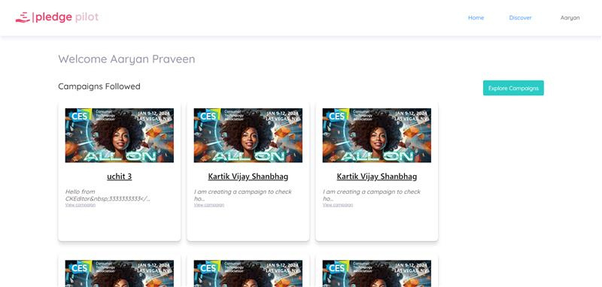
USER DASHBOARD

Slide 9
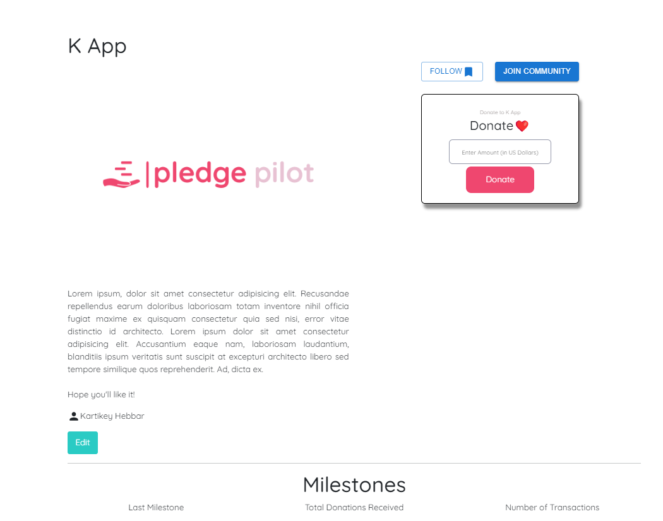
CAMPAIGN DETAILS

Slide 10
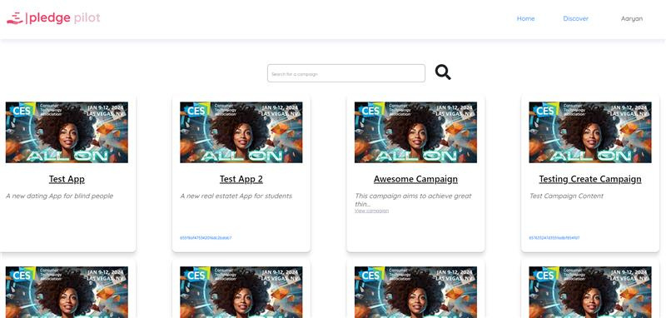
DISCOVER PAGE

Slide 11

LOGIN PAGE

Slide 12
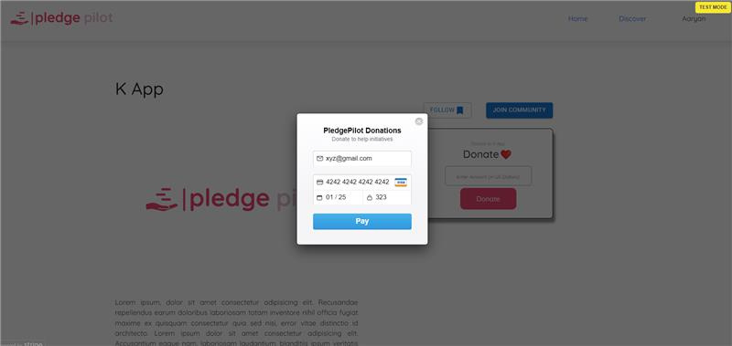
PAYMENT PAGE

Slide 13
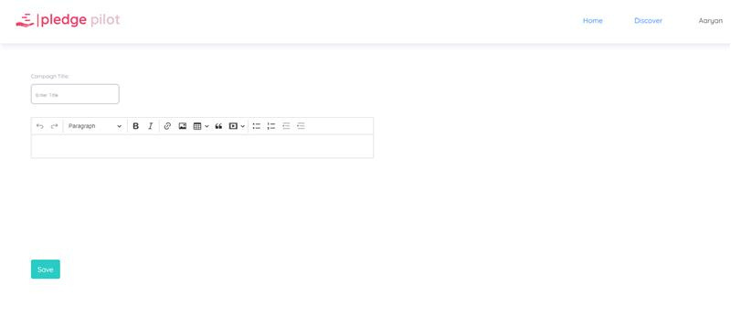
CREATE CAMPAIGN

Slide 14



REFERENCES
https://react.dev/reference/react
https://stripe.com/docs/testing#cards
https://mdbootstrap.com/docs/
https://react-bootstrap.netlify.app/docs/
https://expressjs.com/

Slide 15

Thank you

